Slide 1
CSCI 3081 Final Project
Yash Seella and Mason Hawver

Slide 2
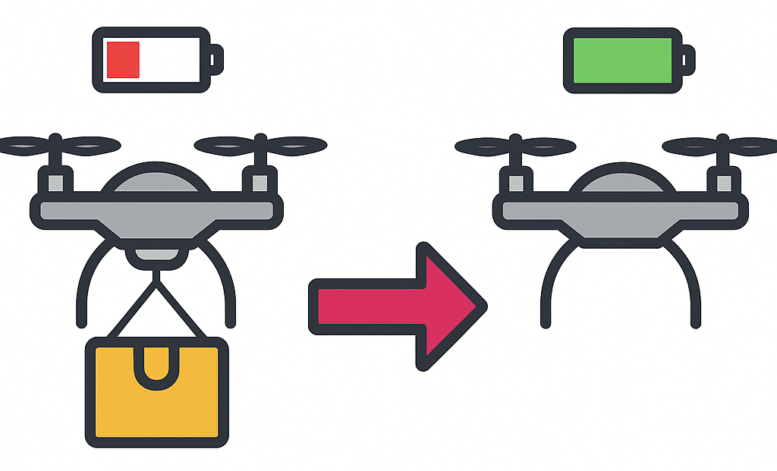
Extension: Multi-Drone Coordination
What is it?
In the base simulation, drones deliver packages independently.
This feature introduces cooperative drone behavior.
Drones can now:
  Request a package handoff mid-delivery if their battery is low
  Request battery donations to reach a package
  Coordinate on who should start a delivery

Slide 3
Extension: Multi-Drone Coordination
How It Works
A drone unable to complete its task publishes a help request
All available helper drones evaluate the situation and bid to assist
The most suitable helper—based on:
  Proximity, Battery level, and Availableness
Coordination built using:
  Compositional, templated Observer pattern
  Centralized singleton message board
Features:
  Decouples drone-to-drone vs. drone-to-user communication
  Allows arbitrary message types via templates
  Entities can subscribe/publish on multiple channels
  Messages live on a shared board, improving cache locality

Slide 4
Extension: Multi-Drone Coordination
Importance?
Mimics real-world operational constraints:
  Limited battery life
  Inability to multitask
  Limited Charging station docking positions
Promotes:
  Realistic simulation behavior
  Improved coordination strategies
  Higher-fidelity data collection

Slide 5
Extension: Data Collection Manager
A new Data Collection Manager extension for the drone simulation
Implements a Singleton class (DataCollectionManager)
Logs per-entity metrics:
  Total distance traveled
  Number of packages delivered, picked up, and handed off
  Batteries “sacrificed”
  Drones recharged by charging stations
Aggregates all data in a std::map<int,EntityStats> keyed by entity ID
Adds an “Export Data” button to the UI to dump the data as stats.csv

Slide 6
Extension: Data Collection Manager
Initialization
  DataCollectionManager::GetInstance() creates one global instance
  Registers the front-end controller as an observer via FrontendNotification
Data Logging
  On each simulation update, LogDistance(this, delta) records movement
  On each delivery, LogDelivery(this) increments that entity’s count
Export Process
  User clicks Export Data in the web UI
  Front end sends an exportData command over WebSocket
  Backend’s transit_service calls ExportToCSV()
  Generates stats.csv with columns for each stat
  Notifies the UI via the observer

Slide 7
Extension: Data Collection Manager
Debugging & QA: Quickly verify that entities moved and delivered as expected
Performance Monitoring: Measure total distances and delivery counts over runs
Analytics & Research: Exportable CSV enables offline analysis with Excel, R, Python - This works doubly well with the new realism from the drone coordination extension
Scalability: Pattern easily extends to additional metrics (battery use, idle time)
User Feedback: Real-time notification confirms successful data export to users

