Slide 1
The Effect of Impossible Spaces on Choice of Locomotion Techniques
By Mason Hawver and Evan Voogd

Slide 2
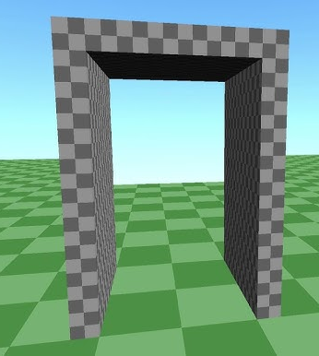
Motivation
The use of impossible spaces, allows a designer to overlap/compress virtual space into physical space
We hypothesis that this will allow users to move more naturally in the scene because they will back track over the same physical space where virtual rooms are overlapped.
Furthermore, Portals and Imposible spaces are cool.
CodeParade. “Non-Euclidean Worlds Engine.” YouTube, 13 Aug. 2018, www.youtube.com/watch?v=kEB11PQ9Eo8.

Slide 3
Previous Work
Previous research on impossible spaces can be broadly summarized as answering the question - “Does implementing impossible spaces detract from the user experience?”
  Suma, et al. introduced the concept into the literature, measured that users do not notice overlaps as high as 56%.
  Mayor, et al. found that impossible spaces do not have a significant impact on presence.
  Jaksties et al. found that users are able to maintain knowledge of their orientation in impossible spaces.
  Warren theorized that the human brain keeps a mental map of their surroundings using a graph instead of a traditional euclidean map, which works well with the graph structure of non-euclidean spaces.

Slide 4
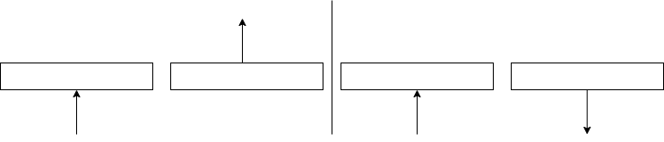
Portals
Visuals:
  Based on tutorial by Daniel Ilet
  One camera/render texture for each eye.
  Place cameras in position relative to near portal, translated to the local position relative to the far portal.
    Similar math for rotation.
  Clip plane to ensure the cameras are not blocked by the far portal.
Teleportation
  Designed by us, not based on a tutorial.
  Box collider to find where the user enters the portal, transforms from world to near portal’s local space to far portal’s local space to world again to calculate ending location.

Slide 5
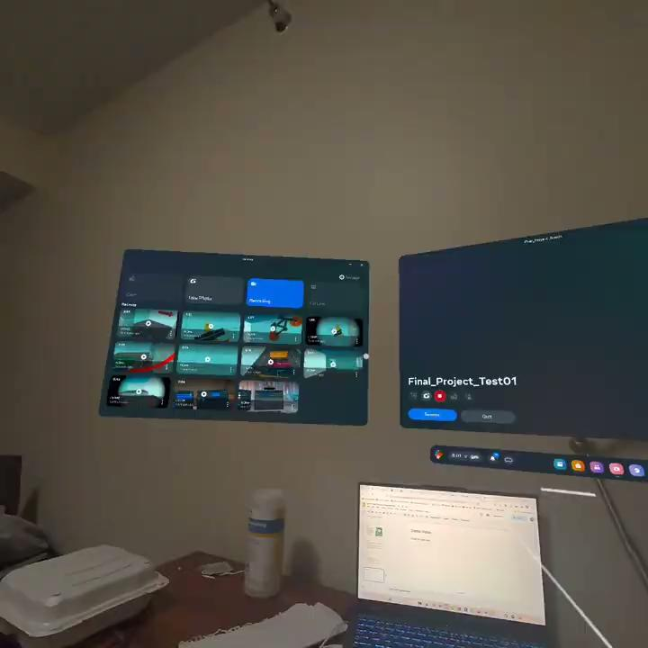

Slide 6
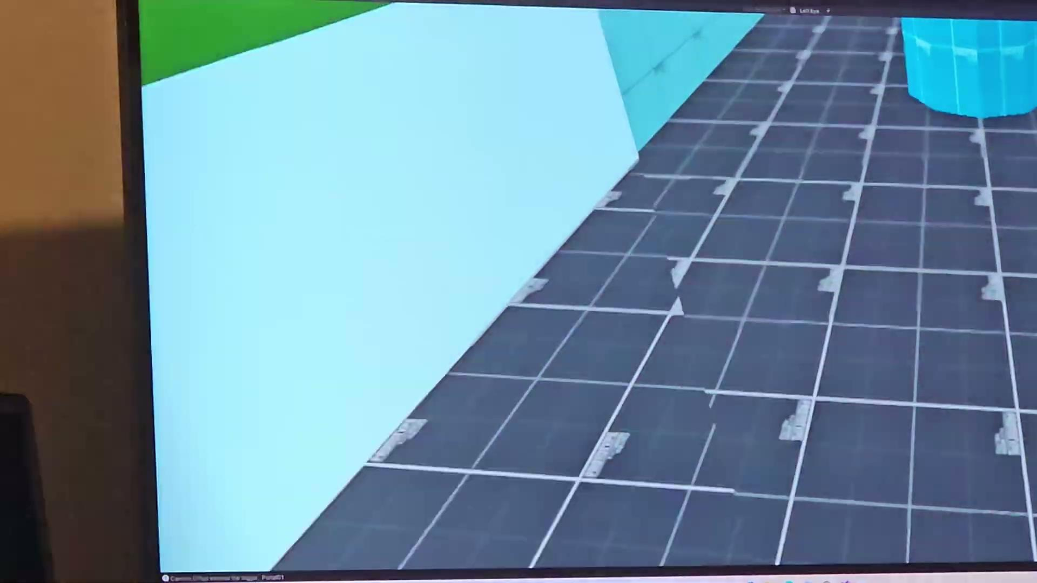

Slide 7
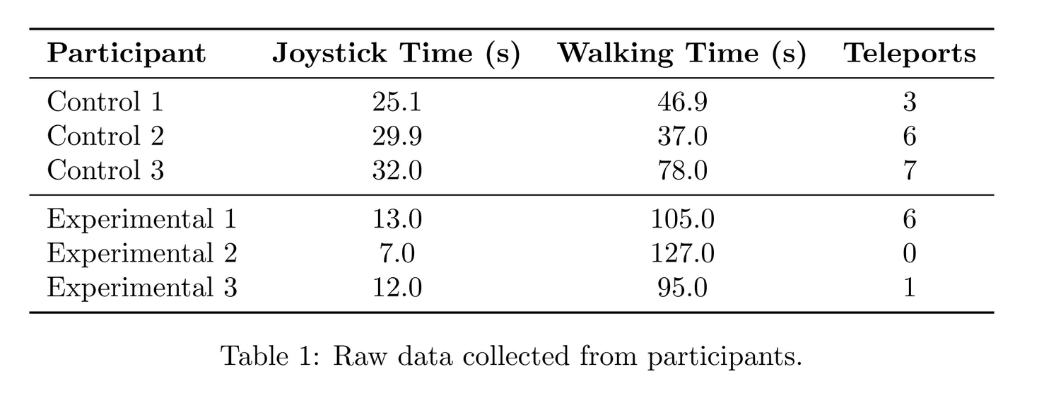
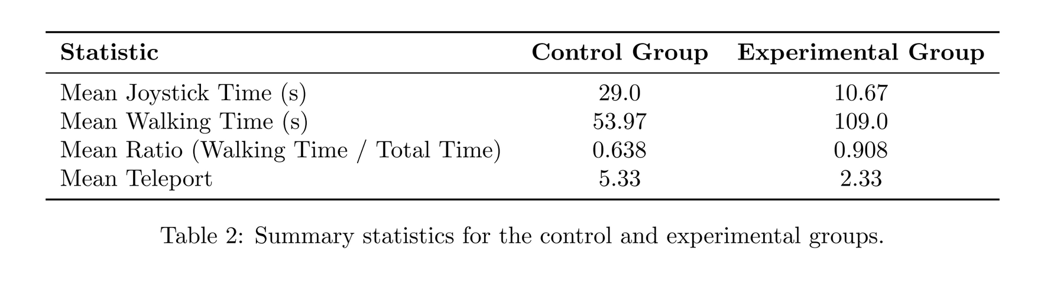





Results
Users performed tasks in both a normal level and in an impossible space that had the same room layout. However the impossible space has compressed all the virtual rooms to one physical space.
We measured the users locomotion statistics, as seen in table 1, while they performed tasks within the level.
Our hypothesis they would relatively walk more in impossible spaces and use their joystick and teleport less
After performing a t-test on these hypothesis. We ACCEPTED that users walked relatively more than using their joystick. But we REJECTED that they teleported less.

Slide 8
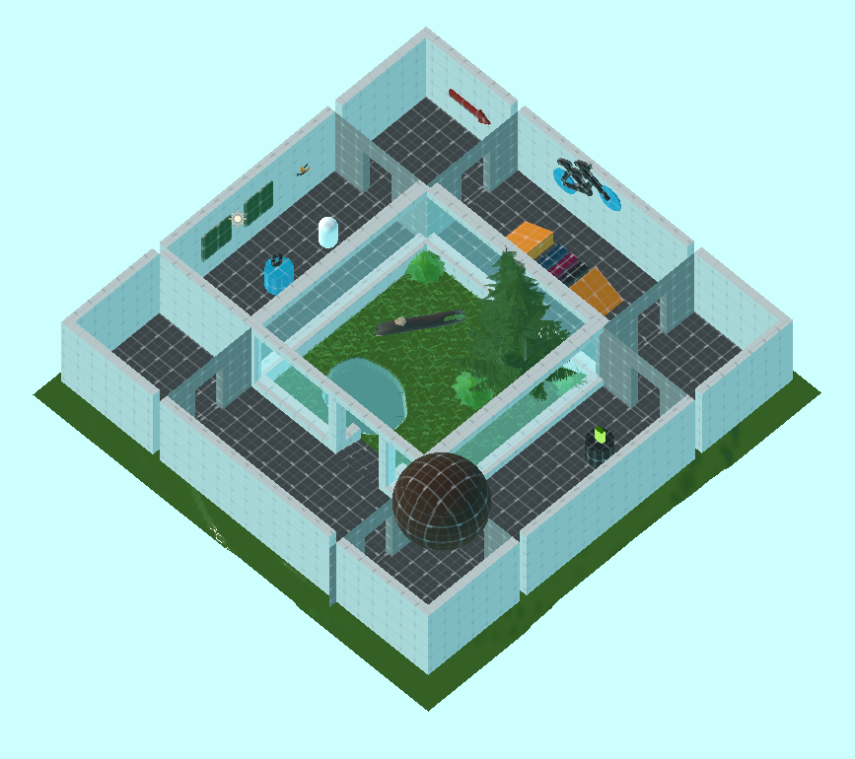

Slide 9
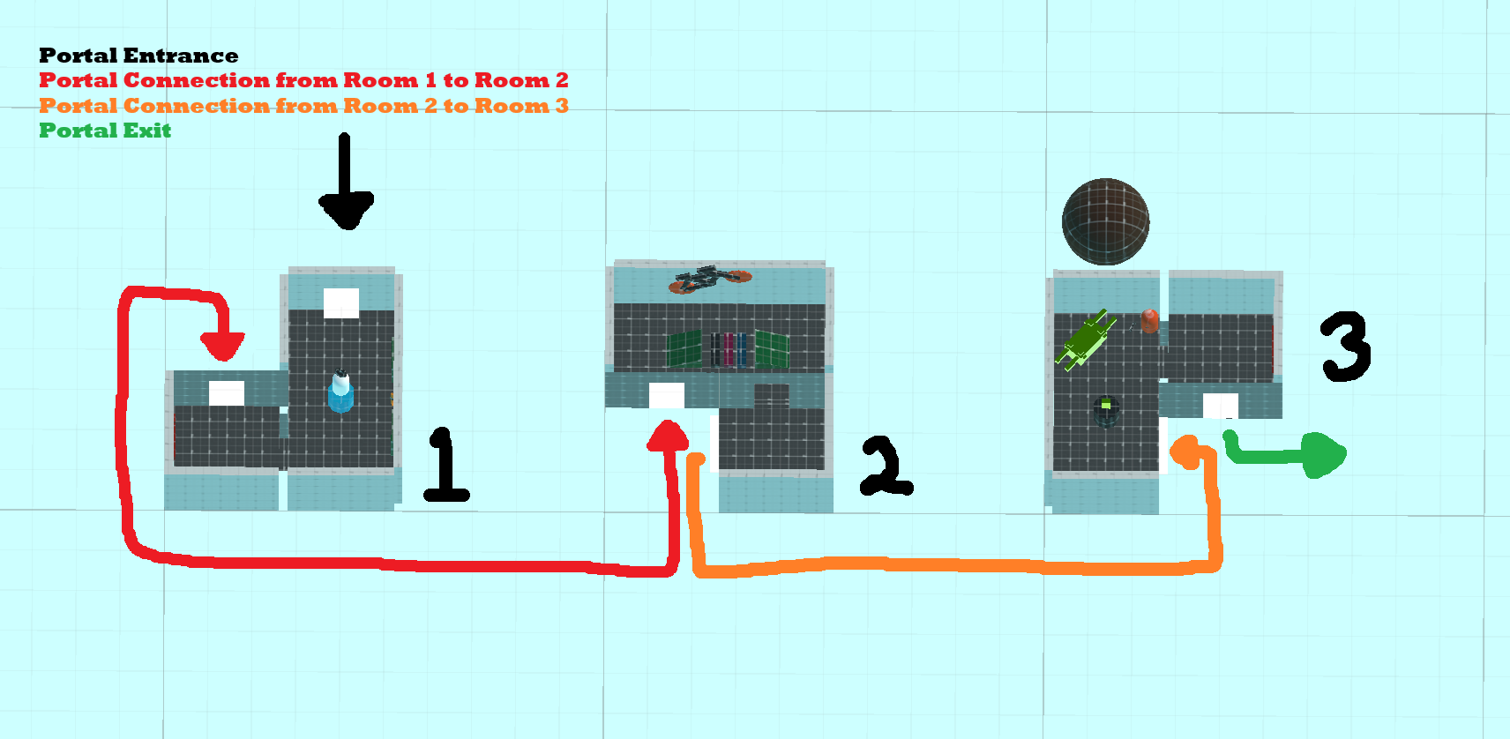

Slide 10


Slide 11
Citations
Alexander Jaksties, Achim Ebert, and Kerstin Müller. 2022. Magical Tower VR - Examining Orientation in Non-Euclidean Spaces. , 6 pages. https://doi.org/10. 1145/3552327.3552344
Daniel Ilett. 2019. Portals. https://danielilett.com/2019-12-01-tut4-intro-portals/
Jesus Mayor, Daniel López-Fernández, Raúl Lara-Cabrera, and Fernando Ortega. 2024. Virtual Reality Presence in Partially Non-Euclidean Environments. , 14 pages. https://doi.org/10.1162/pres_a_00419
E. A. Suma, Z. Lipps, S. Finkelstein, D. M. Krum, and M. Bolas. 2012. Impossible Spaces: Maximizing Natural Walking in Virtual Environments with Self-Overlapping Architecture. , 555–564 pages. https://doi.org/10.1109/tvcg.2012.47
William H. Warren. 2019. Non-Euclidean navigation. Journal of Experimental Biology 222, Suppl1 (022019), 𝑗𝑒𝑏187971.

