Slide 1
Quantum Cryptography
Coin Flipping and Secret Key Distribution
Blake Briol, Mason Hawver, Dan Hawker, and Wyatt Furois

Slide 2
Structure of Presentation
The Mathematics of Quantum Information Theory
  Inner Products
  Hilbert and Dual Spaces
  Qubits and Conjugate Bases
Key Distribution
  BB84 Protocol
  Eavesdropping Protection
Quantum Coin Flipping and Protocols
  The Quantum Coin Flip
  Original QCF
  Practical QCF
Zero-Knowledge Proofs
  Components
  Discrete Log
  Problems

Slide 3
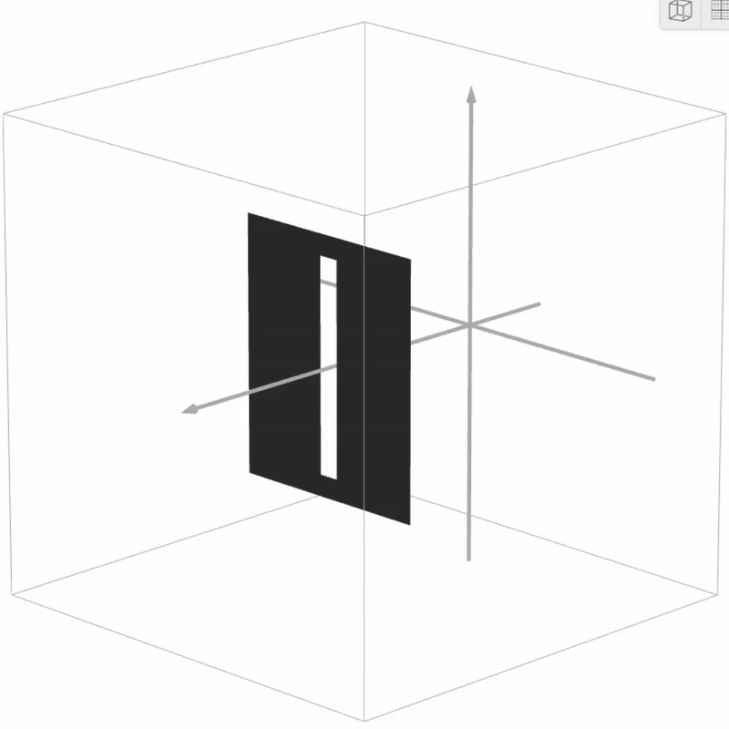
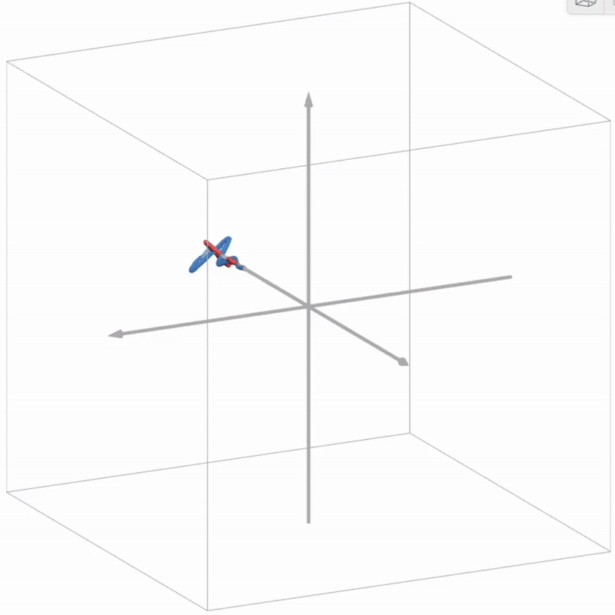
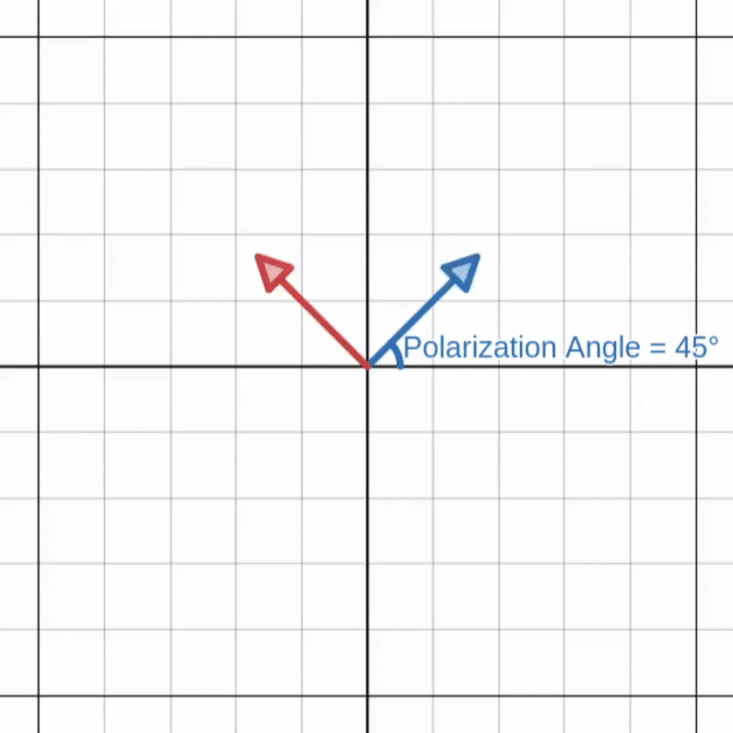
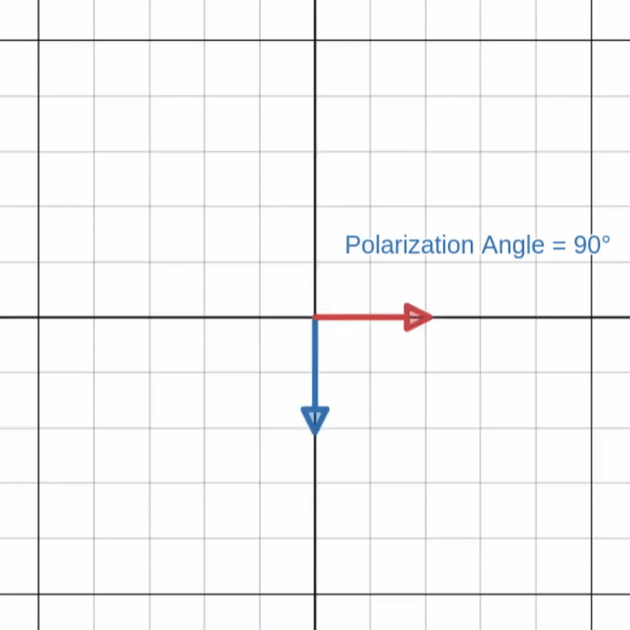
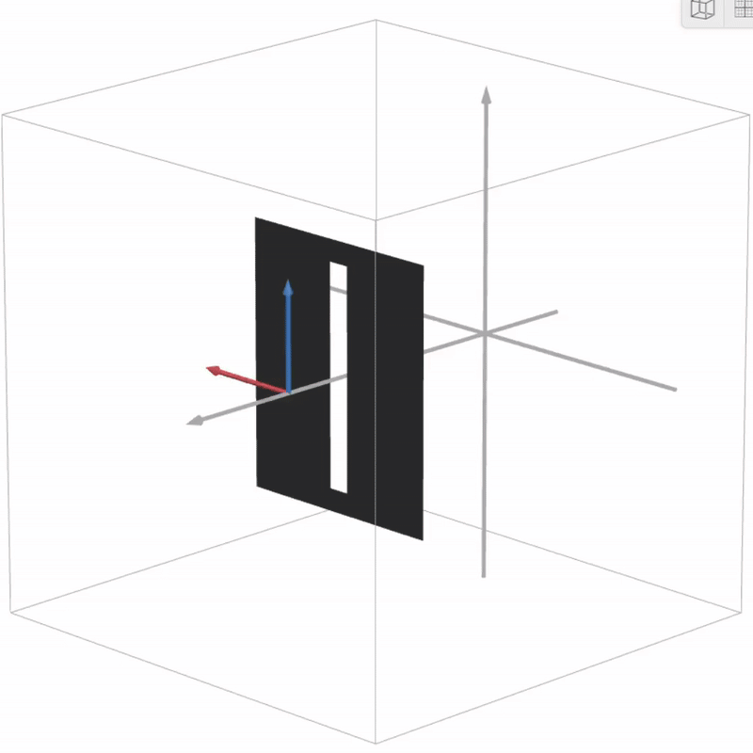
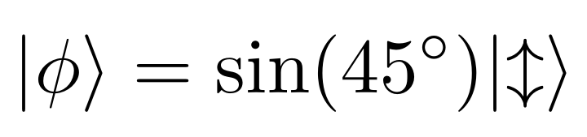
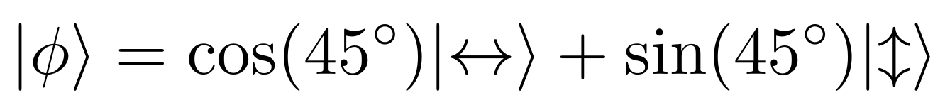
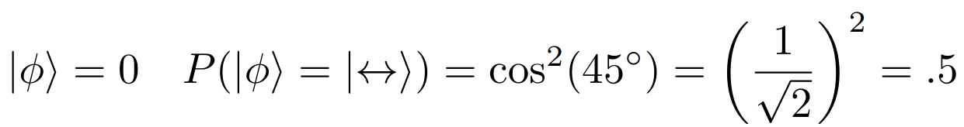
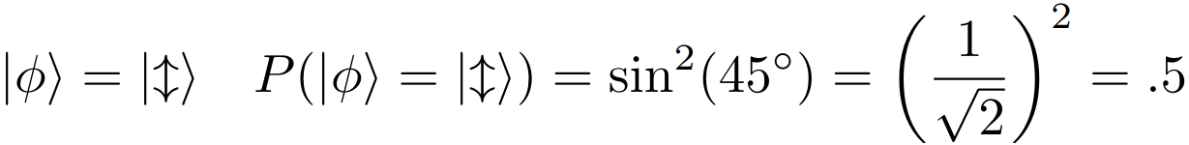
Quantum Information Fundamentals
Classically Light is understood as a electromagnetic wave
Light Polarization describes the direction that the wave oscillates in
If it were measured by a vertical polarization filter what would happen?
  Would only the vertical component survive? No.
Now it's understood that the energy stored by this wave is discrete, So it can not be continuously split into its components.
  So what will happen? It probabilistically collapses into either its vertical or horizontal component.
Notes:
Conclude with saying the light polarization, is the simplest realization of a qubit

Slide 4
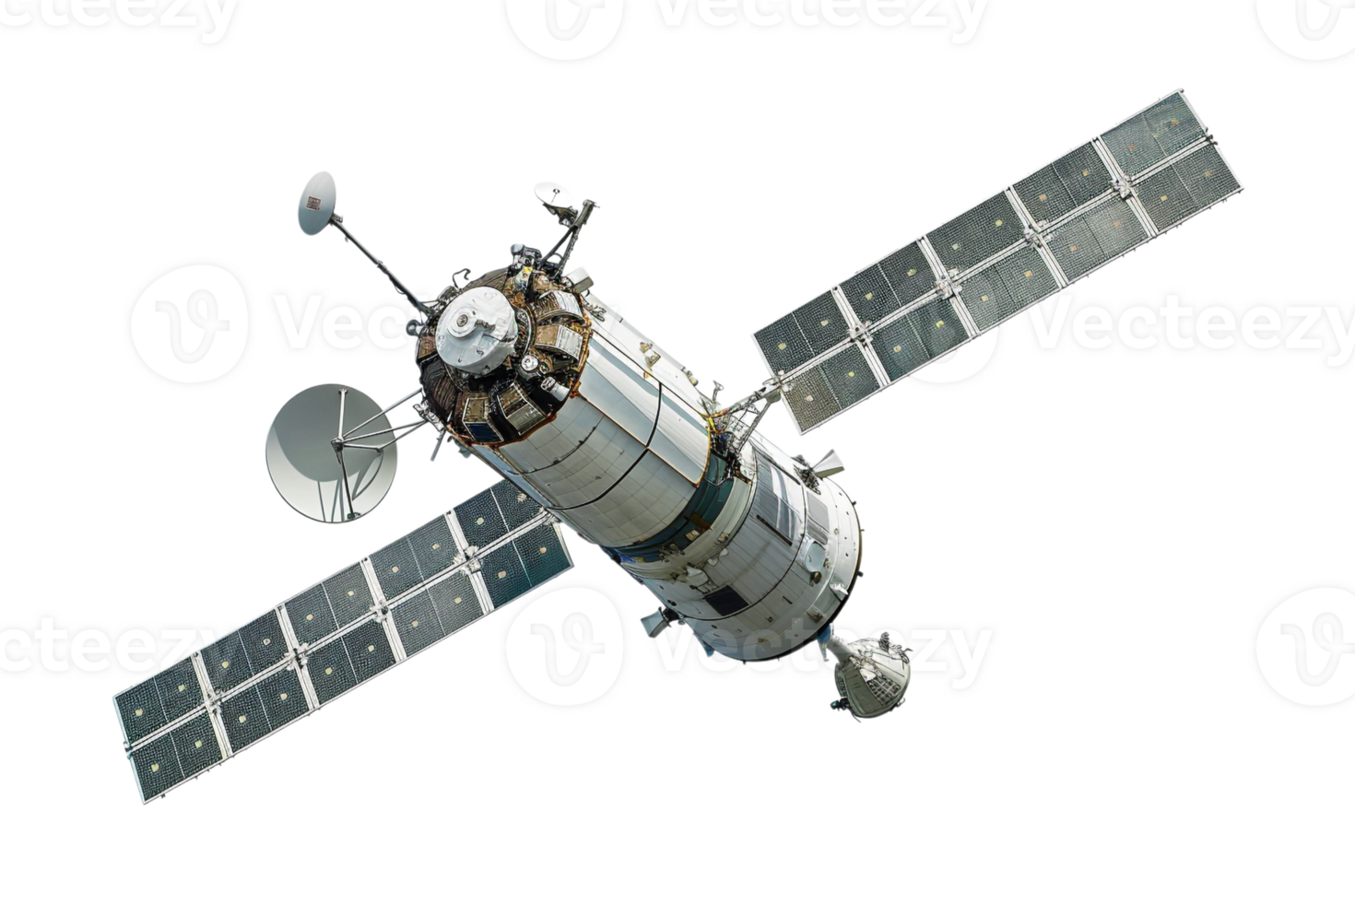
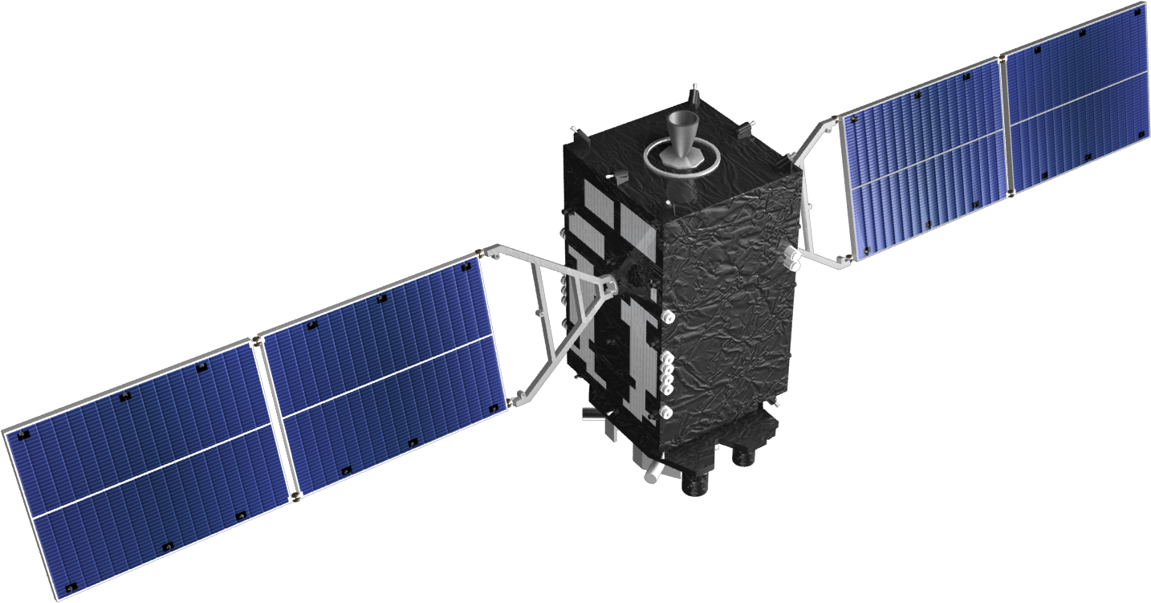
Satellites use the Quantum properties of light as the physical backbone of Quantum protocols like QKD, and have used this technology since the 90s
Classical communication protocols rely on assumptions of computational hardness for their security which can be broken by technical advances like quantum computers.
Quantum communication is provably secure due to the guarantees of the physical laws of quantum mechanics

Slide 5

Dirac Notation - The Language of Quantum Mechanics (1)
Created and popularized by Paul Dirac
  1902-1984, United Kingdom
  Also Called Bra-Ket Notation, for reasons that will soon become obvious
Inner Product
  We will derive Bra-Ket notation from the definition of the inner product
  An Inner Product is an operation of two vectors such that it satisfies the following properties:
    Linearity:
    Symmetry:
    Positive Definiteness:
The Hilbert Space
  Created by David Hilbert
    1862-1943, Germany
  Fundamental in the study of quantum mechanics
    H is a Hilbert Space iff:
      There exists a defined inner-product
      H is Cauchy Complete (Cauchy sequences converge in H)
      H is a Metric Space (There exists a distance function)
    I.e. The Real numbers (N) equipped with the dot product
    The Complex Numbers equipped with a complex inner product

Slide 6

Dirac Notation - The Language of Quantum Mechanics (2)
The Dual Space
  H* is a Dual Space of H iff:
    Functions that act on vectors in H that return scalars (known as a linear functionals) are in H*
      From this definition, we can more clearly state that H* is the set of all linear functionals acting on H
    Thus, we can read as acting upon using a linear functional and thus forms H* for vectors in H
  Finally, we can denote the dirac notation as follows:
    Bra - - is a row vector in H* that can be applied to a Ket as a linear functional
    Ket - - is a column vector in H
      You can think of squaring the amplitude of the Ket as the probability of finding a system in that state
      You can think of the Bra as the row vector transpose mapped from the Ket via a linear functional (or as a linear functional)

Slide 7

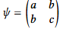
Quantum bits or Qubits
The informational elements of quantum information theory
  Instead of representing a 1 or 0 like classical bits, they represent a superposition of both states
We can define an isolated qubit as follows
  represents an isolated qubit state iff:
    , and such that:
    A
  Fundamental qualities of a qubit are also as follows:
    A
    This is to say that the probabilities of the state add up to one such that P(0)+P(1)=1
We will now move on to a some representations of the qubit state Psi!

Slide 8
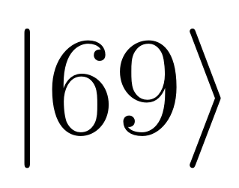
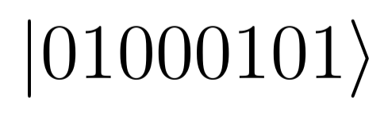
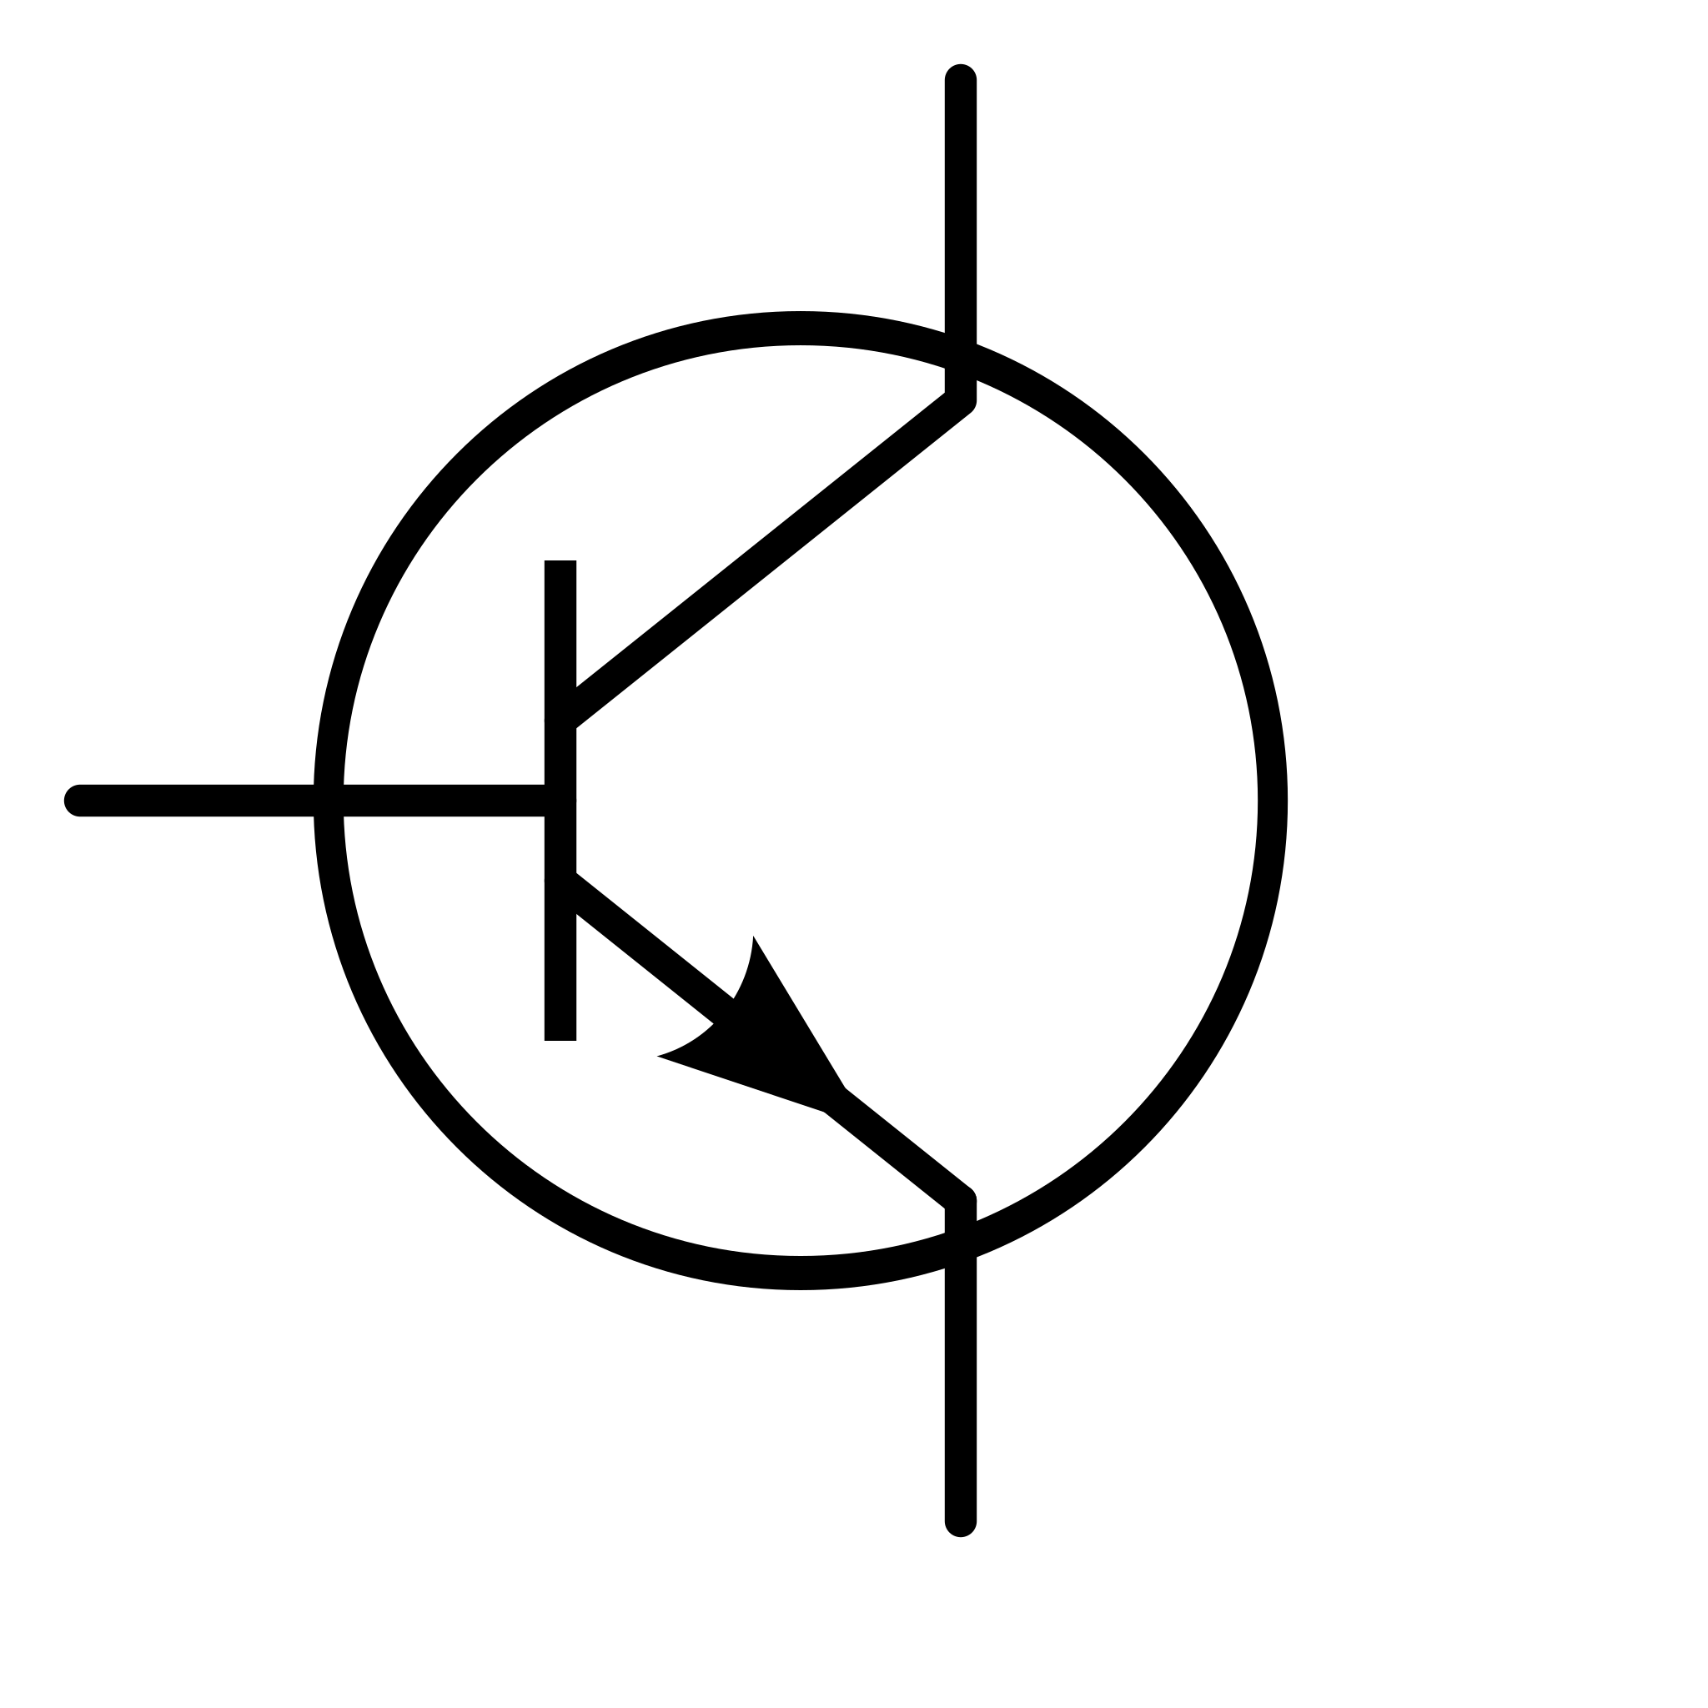

Quantum Information Fundamentals
Classical
Quantum
Data types
67 or ‘C’
Bits
0b01000011
Layers of Abstraction
Physical
Notes:
Conclude with saying the light polarization, is the simplest realization of a qubit

Slide 9
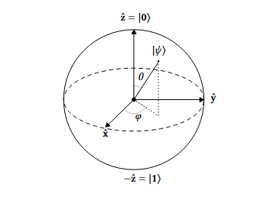
The Bloch Sphere!
We can interpret the state of the qubit as a point on the surface on the Bloch sphere
*This is derived via a coordinate transformation of the Pauli operators

Slide 10


Conjugate Basis
A conjugate basis is important to note in the discussion of QIT, so here is a brief description
  Two orthonormal basis’ form a conjugate basis for H iff for all pairs of indices the following holds:
    is
    This can be read as measurement from the perspective of either or is equal or the amplitude of the inner product is ½ where either member of the orthonormal basis’ can be in either the first or second entry

Slide 11
Quantum Key Distribution - QKD
Problem: need to establish secret keys between parties
In classical setting:
  Reliant on one-way functions
  Computational security
However, in a quantum setting:
  No cloning theorem, measurement collapse, Heisenberg uncertainty principle
  Information-theoretic security, including eavesdropping detection

Slide 12
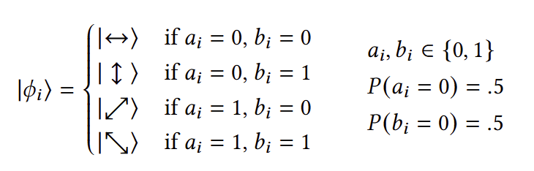
Quantum Key Distribution - BB84 Protocol
Alice and bob agree on two conjugate bases (Rectilinear and Diagonal)
Alice prepares N random qubits by choosing strings a and b
  Each string is a string of N equally random bits
Alice sends qubits to Bob over a quantum channel
Bob measures each qubit in a randomly chosen basis
Alice and Bob compare bases and discard unmatched bits
Alice and Bob test a subset of qubits for eavesdropping and establish key with the sifted bits

Slide 13
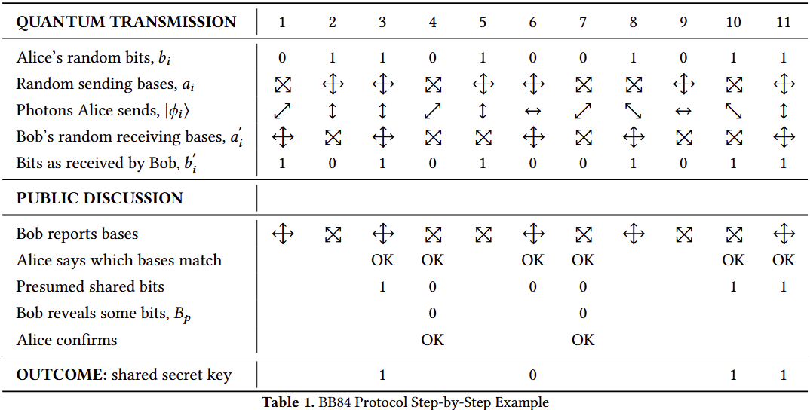

Slide 14
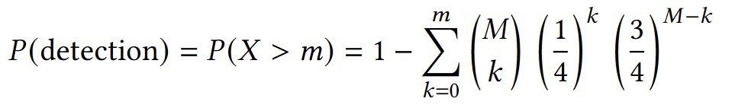
Quantum Key Distribution - Eavesdropping Protection
Eavesdropper (Eve) must guess Alice’s basis with 50% probability
When Eve’s basis != Alice’s basis: qubit collapses to superposition
This introduces errors in Bob’s measurements
When to abort?
If we want to catch Eve 95% of the time, and we use 64 bits for testing, there should be at most 9 bits mismatching before aborting the protocol.
Why not 1 mismatch? Eve can more easily abort the process.

Slide 15
Quantum Mechanics in Public-Key Distribution
The no-cloning theorem prevents replicating quantum states
The Heisenberg uncertainty principle
Measurement collapse
We can leverage these principles to make an information theoretic secure protocol
  Meaning the protocol is secure against an adversary with unlimited computing resources and time

Slide 16
Public-Key Distribution
In a classical setting, one-way trapdoor functions are used to ensure key security
These functions are considered secure due to being computationally infeasible to reverse
  I.e. they are computationally Secure
However, these functions are not provably secure, and vulnerable to eavesdropping
We can leverage quantum mechanics to achieve these goals

Slide 17
BB84
Developed by Bennett et al. in 1984
Requires a quantum and classical channel
Alice, Bob agree on a pair of conjugate bases for encoding and measurement
Alice prepares a stream of qubits
  For each qubit, Alice chooses a random conjugate base, and a random component of that base for encoding.
Alice sends the qubits to Bob, who measures each with a random base
Alice and Bob communicate which bases were used for encoding and measurement, and keep the bits where these values agree

Slide 18
Todo
Introduce the problem the protocols aim to solve
Introduce an intuitive understanding through light polarization.
Introduce the coin flipping protocol
Introduce key distribution protocol
Done
Good slideshow to go over: https://research.engineering.nyu.edu/~jbain/philqm/lectureslides/07a.QIT.QuantCrypt.pdf
7 - 5 slides max so that we can have 2 minutes a slide

Slide 19
Coin Flipping
Overview
Goal: Two parties want to agree on a fair, random bit, like flipping a coin
Why: Key agreement protocols (Diffie-Hellman), Fair Online Games, Zero Knowledge Proofs, Blockchain
Challenge: Ensure fairness even if one party is malicious and has unlimited computational power
Classical Coin Flipping
In asynchronous protocols, one party can always force a specific result
In synchronous protocols, there is still a limit on how fair it can be - someone may always cheat a little

Slide 20
Quantum Coin Flipping
Overview
The first quantum coin flipping (QCF) protocol came in 1995
Important demonstration: Even if an adversary intercepts all communication, quantum mechanics prevents them from altering the outcome
Since then, improvements focused on
  Lowering cheating probabilities
  Making the protocols practical in real world settings
  Extending to multiple parties

Slide 21
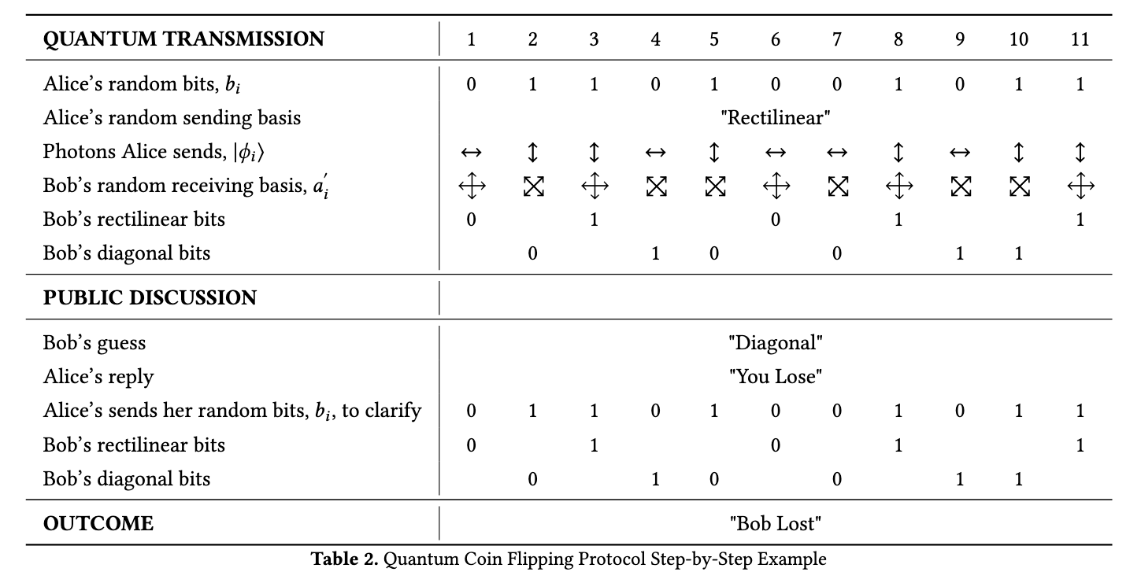
Original QCF Protocol
Protocol
Alice chooses a bit string and a secret encoding basis (rectilinear, diagonal, etc.)
Alice prepares her qubits using that basis and sends to Bob
Bob randomly chooses a measurement basis, and measures the incoming qubits
Bob announces his guess of Alice’s basis through a classical channel
Alice reveals her original basis and bit string
If guess is correct, then their measurements will match, otherwise they will match only 50% of the time
  This makes detecting cheating easy, as there will be statistical inconsistencies
Upscaled table on next slide

Slide 23
Practical QCF Protocol
Overview
Uses an attenuated laser source, which is more practical than previous methods and can be implemented in the real world with more success
Lower cheating probability than previous quantum protocols, approaching the proven minimum

Slide 24
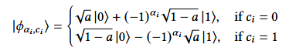
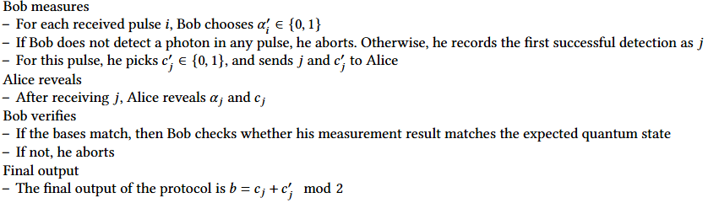
Practical QCF Protocol
Protocol
Alice generates photon pulses to send to Bob. For each pulse she randomly selects a basis and a bit, and prepares a quantum state. (see above)
  The a parameter gets tuned when reducing the cheating probability
For each received pulse, Bob chooses a basis.
On the first successful detection, Bob records it, chooses a bit, and sends them to Alice
After receiving this information, Alice reveals her original bit and the basis she used to encode it
The final output of the protocol is

Slide 25
Practical QCF Protocol
Aborts and Cheating
Honest aborts are caused by photon detection issues, dark counts(false positives on the photon detector), or noise on the channel
Cheating
Alice may try to send an entangled quantum state to control the outcome
Bob may choose to measure specific pulses, rather than the first he sees
The “a” value is tuned to make these probabilities equally likely

Slide 26
N-Party QCF
Why do we need to extend the coin flip to N parties?
Needed when more than two parties must agree on a random bit
Examples
  Distributed decision making
  Blockchain consensus
  Quantum networks - connect multiple users via quantum channels

Slide 27
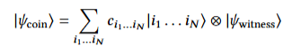
Central Review Protocol (N-party)
Overview
Uses a witness to ensure that the process is fair and verifiable
Protocol
All players share an entangled quantum state with the witness
Hadamard Operation is applied to each player’s qubit, putting it into a superposition between 0 and 1
Each player “flips” their coin by measuring it in the {0,1} basis
  Witness can track the results by measuring all of the entangled qubits
After all players have flipped, then a bit can be deduced from the final state

Slide 28
Peer to Peer Review Protocol (N-party)
Overview
All participants review all results - more complex and slower than a witness
Protocol
All players share an entangled quantum state
Each player flips their coin by measuring in the {0,1} basis, evolving the quantum state
After all flips, the results are reviewed for each player, by everyone
An agreement ratio is calculated, and if it is high enough, it passes, and the result of the flip can be determined from the final quantum state

Slide 29
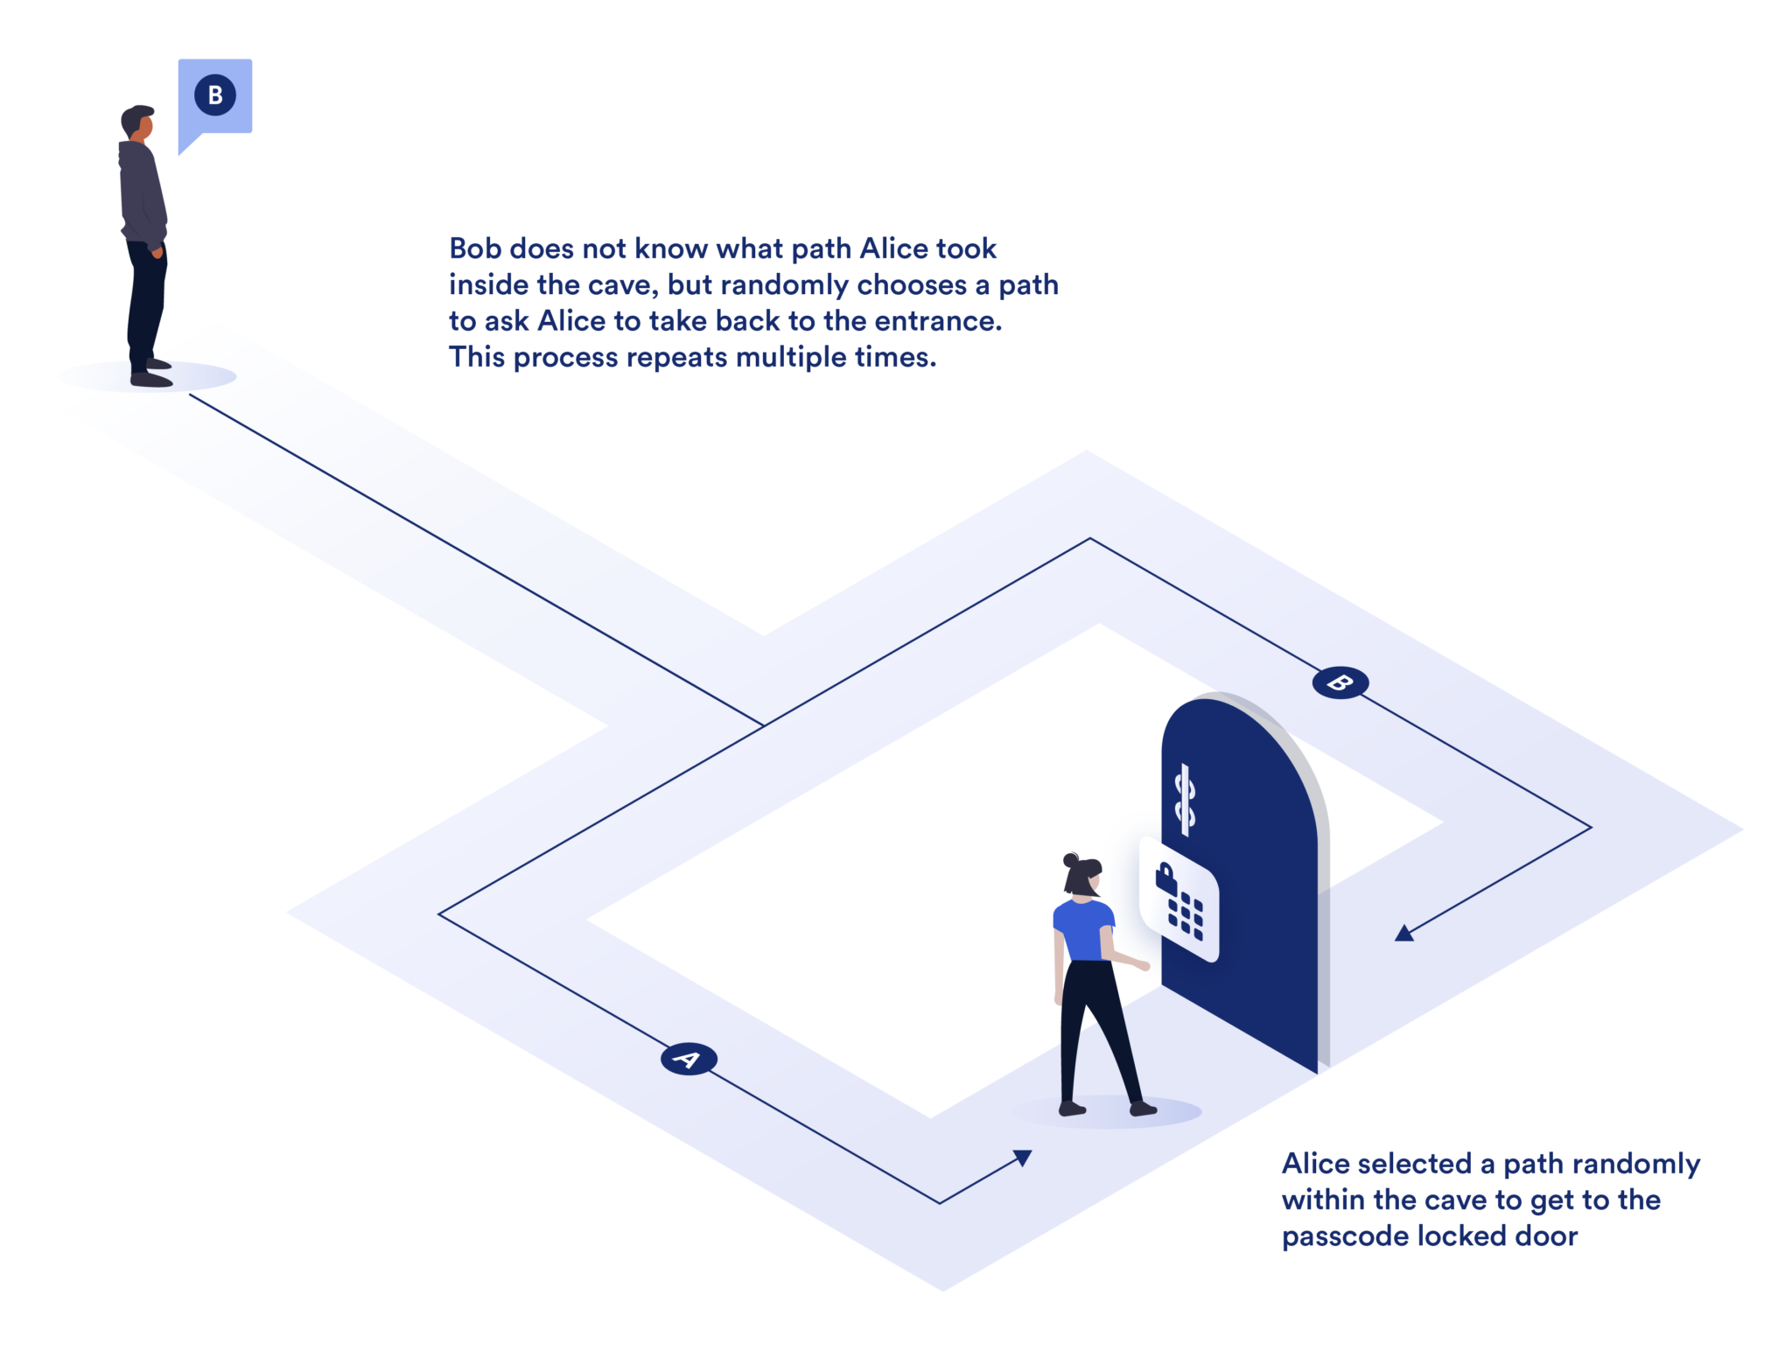
Zero-Knowledge Proofs
ZK allows a statement to be proven without revealing any additional information.
Three components must be satisfied:
  Completeness: If the statement is true, an honest verifier will be convinced by an honest prover
  Soundness: If the statement is false, a dishonest prover cannot convince an honest verifier that it is true, outside of a small probability.
  Zero-knowledge: Formally, every verifier has some simulator that given the statement, a transcript can be produced that looks like an honest prover and the verifier.
Notes:
Ali baba’s cave

Slide 30
Zero-Knowledge Proofs - Discrete Log of a Given Value
Known as Schnorr Identification Protocol
Goal: convince verifier of knowledge of some 𝑥 such that 𝑦＝𝑔ˣ mod 𝑝
Cyclic group 𝔾 of (large) prime order 𝑝, with generator 𝒈
Alice selects some random r ∈ 𝕫ₚ and sends commitment 𝒕, where 𝒕＝𝑔ᣴ mod 𝑝 to bob.
Bob selects a random challenge Ｃ∈ 𝕫ₚ and sends Ｃ to Alice
Alice computes response s＝r +Ｃ·𝑥, and sends s to Bob.
Bob then checks that 𝑔^{s}＝𝒕·𝑦^{C}, and accepts/rejects accordingly
Note:
Because this protocol relies on discrete log hardness, this is easily broken in the quantum setting by Shor's algorithm.
However, the structure of the protocol and necessary randomness of the commitment and challenge can be the same when using a quantum-hard problem.

Slide 31
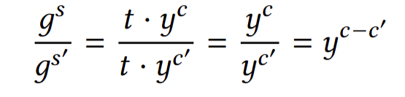





Zero-Knowledge Proofs - Components Revisited
Completeness: With both parties following the protocol honestly, Bob will always accept the proof.
Soundness: If Alice can provide two correct s for one r, the secret key 𝑥 can be extracted.
Zero-knowledge: We can simulate a transcript (t,c,s) that passes the verification step by working backwards through the protocol.
  Choose some C ∈ 𝕫ₚ, pick a random s ∈ 𝕫ₚ and solve for 𝒕

Slide 32
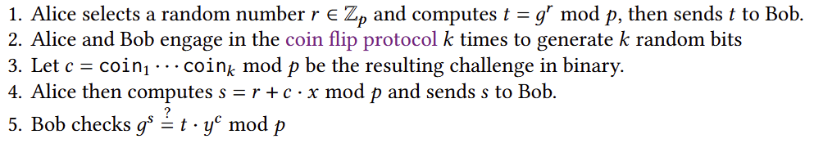
Zero-Knowledge Proofs - Coin Flipping?
It’s important that the challenge is generated randomly and fairly.
What happens when it’s not? For instance, what if Bob chooses a C based on 𝒕, C = 𝑓(𝒕)?
  Soundness: If C is not uniformly distributed, Alice may be able to predict C and provide a valid 𝒕 and s
  Zero-knowledge: The protocol is no longer simulatable, as we need to choose C before 𝒕 in the simulator.
Solution
Use the coin flip several times, then concatenate to form a challenge value in binary.

Slide 33
Conclusion
The Mathematics of Quantum Information Theory
  Inner Products
  Hilbert and Dual Spaces
  Qubits and Conjugate Bases
Key Distribution
  BB84 Protocol
  Eavesdropping Protection
Quantum Coin Flipping and Protocols
  The Quantum Coin Flip
  Original QCF
  Practical QCF
Zero-Knowledge Proofs
  Components
  Discrete Log
  Problems

Slide 34
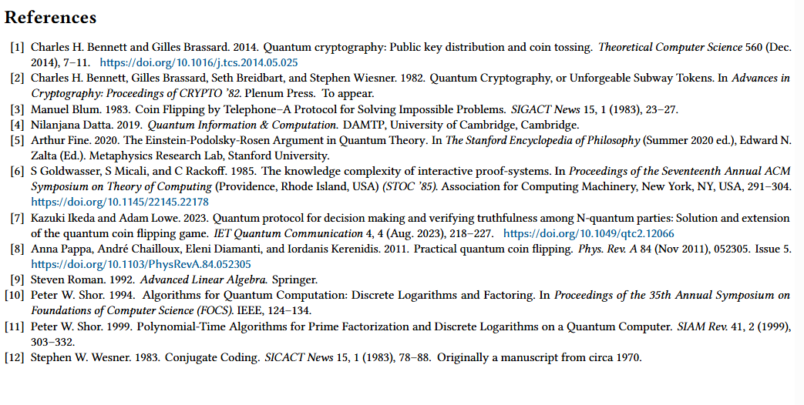
[13]
Ali Baba’s Cave image - https://chain.link/education/zero-knowledge-proof-zkp
Notes:
Conclude with saying the light polarization, is the simplest realization of a qubit

Slide 35
Thanks for Watching!

